Slide 1


Robust Path Planning and Control for Polygonal Environment via Linear Programming
Mahroo Bahreinian
Advisor: Roberto Tron

Slide 2
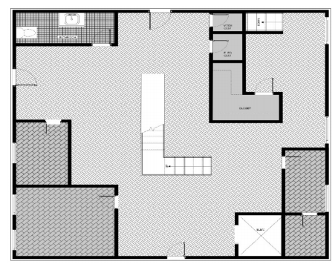
Research Sections
Navigation

Slide 3
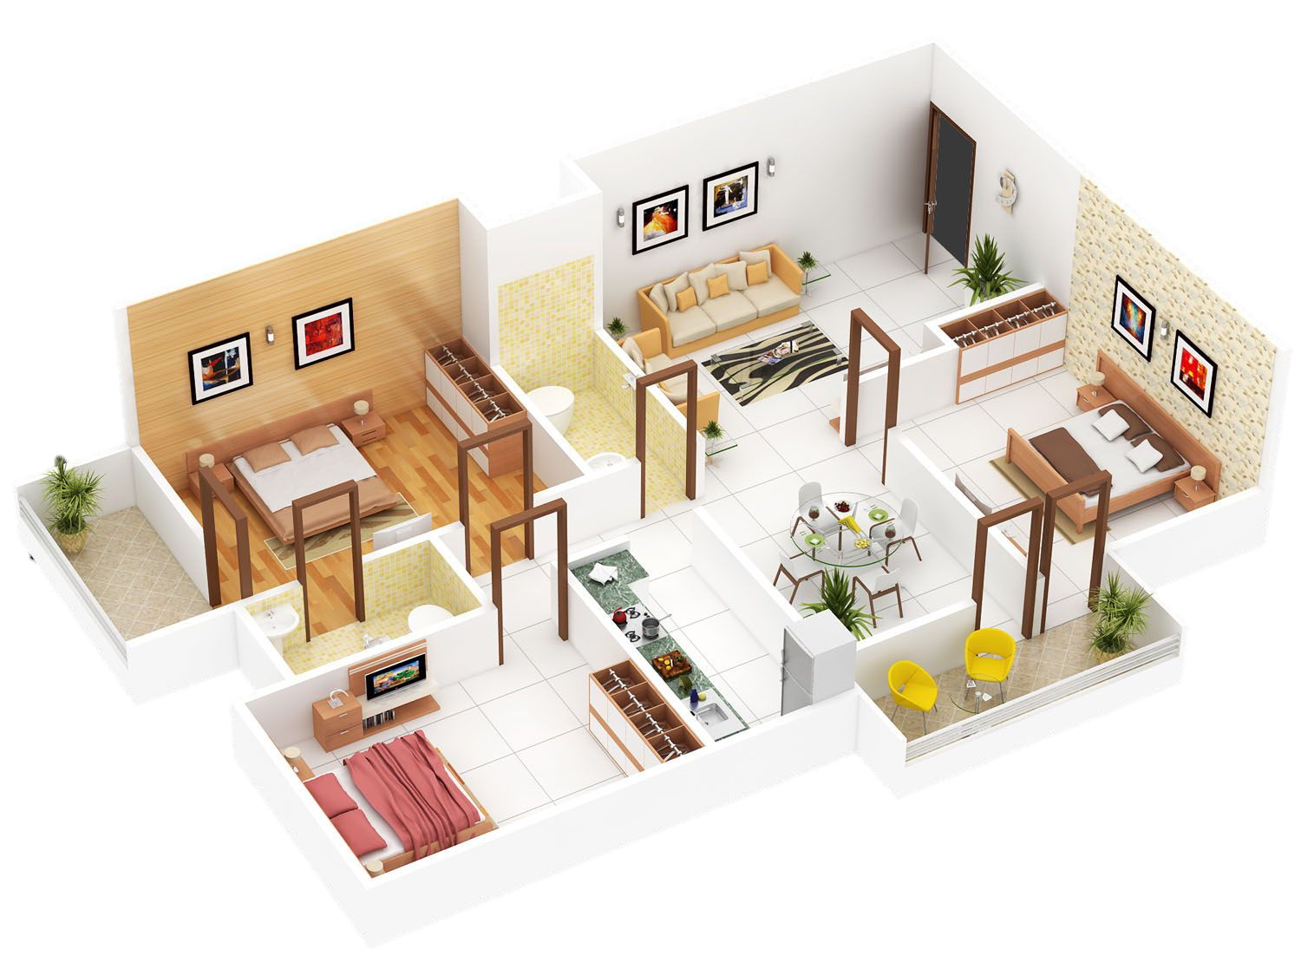

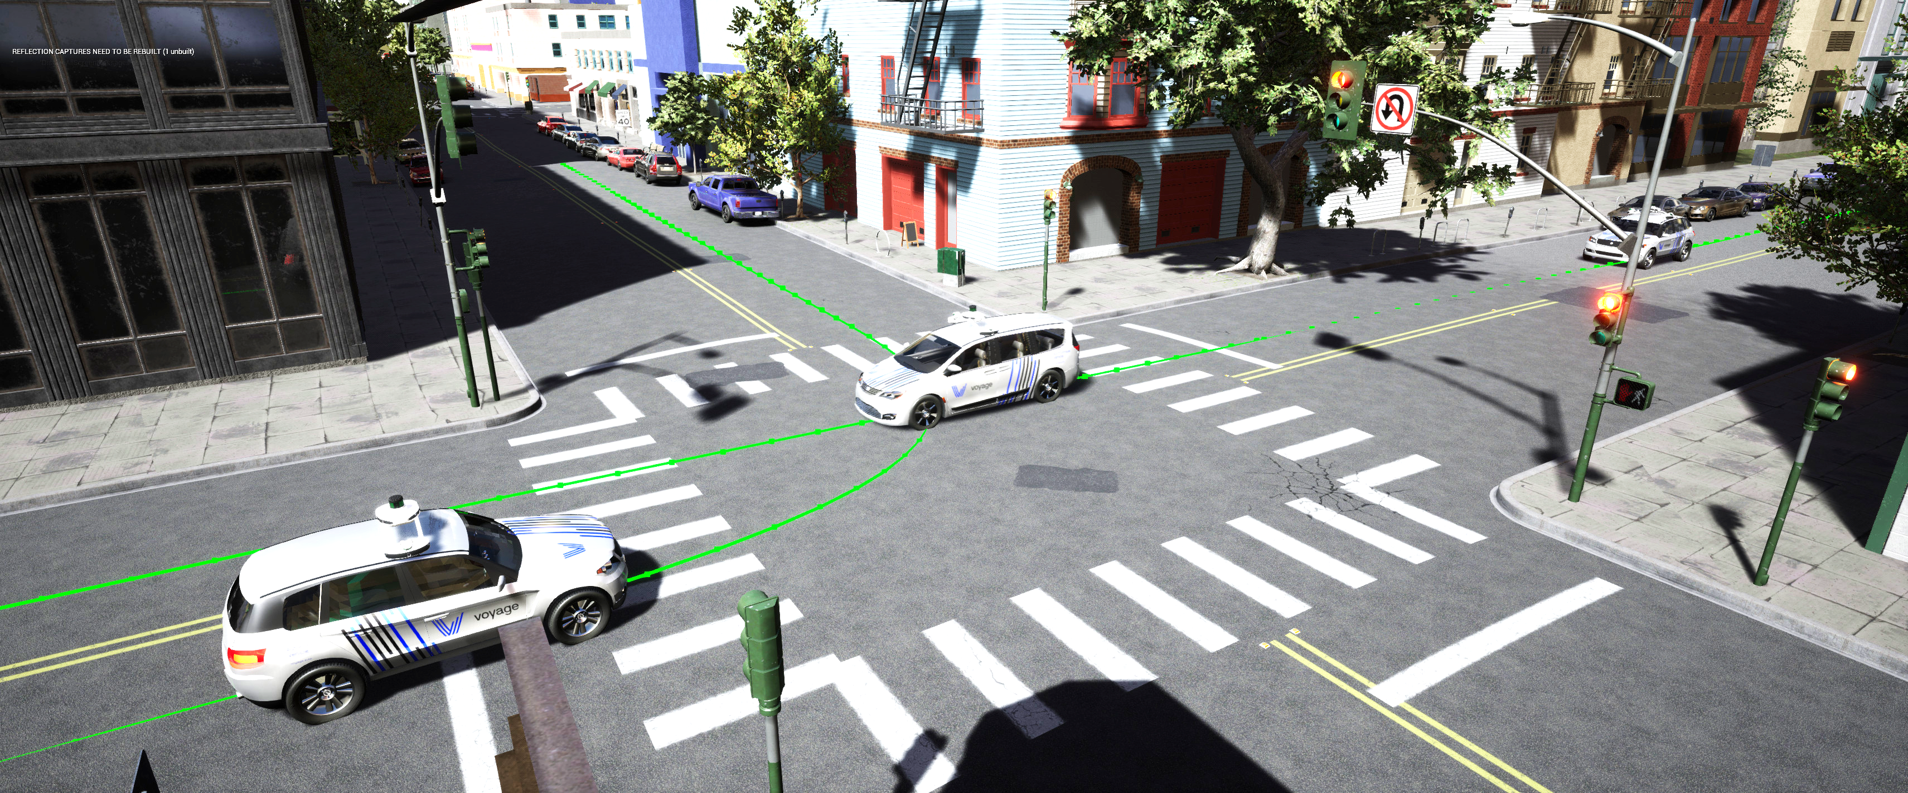
Control
Synthesize Output-feedback controller
Plan with measurement from environment
Robust to significant change in environment
https://www.roboticsbusinessreview.com/news/voyage-launches-deepdrive-simulation-platform/
https://www.fiverr.com/atifkhan223/make-isometric-3d-plan

Slide 4
Control, Previous Works
Path Planning
Combinatorial:
Sample-based:
cell decomposition
full state feedback
RRT, RRT*, LQR-tree
In this work: synthesize set of output-feedback controllers on a convex cell decomposition of a polygonal environment via Linear Programming

Slide 5
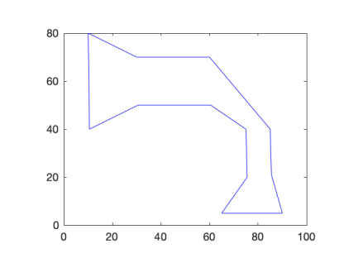
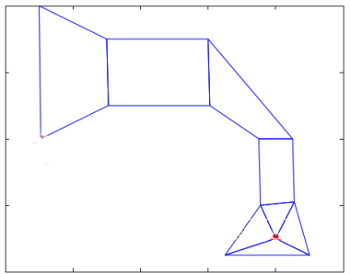
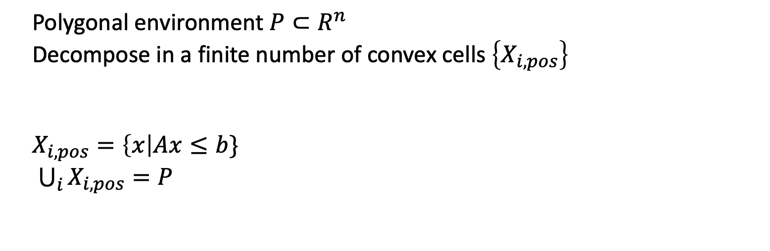
Theory, Cell Decomposition
Polygonal environment $P⊂R^{n}$
Decompose in a finite number of convex cells $\left\{X_{i,pos}\right\}$
$X_{i,pos}=\left\{x\right|Ax≤b\}$
$\bigcup_{i}{X_{i,pos}=P}$

Slide 6
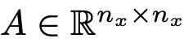
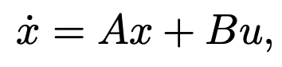
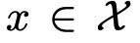
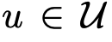
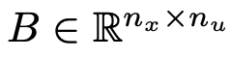
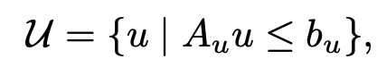
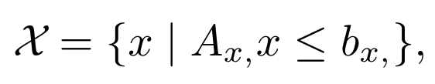
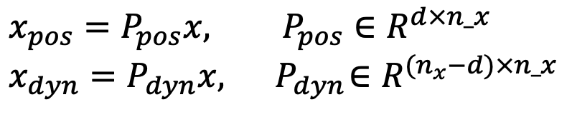
Theory, System Dynamics
$$x_{pos}=P_{pos}x, P_{pos}∈R^{d×n_x}$$
$$x_{dyn}=P_{dyn}x, { P}_{dyn}∈R^{(n_{x}−d)×n_x}$$

Slide 7

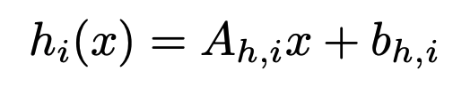
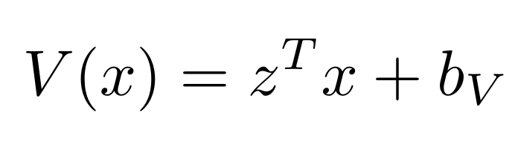
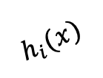
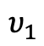
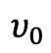

Theory, Problem
$$υ_{0}$$
Exit face
$$z$$
$$υ_{1}$$
$$h_{i}(x)$$

Slide 8
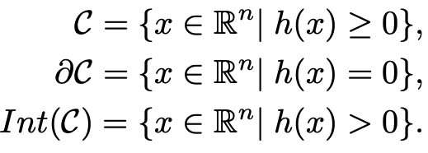
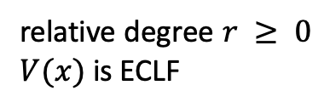
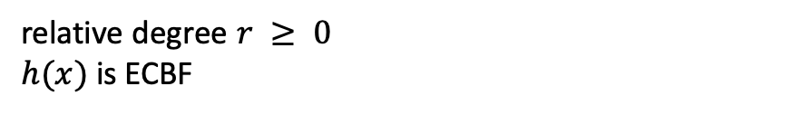
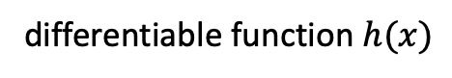
Theory, CBF and CLF
Safety Constraints by Control Barrier Function:
differentiable function $h(x)$
$C$is forward invariant if $x(t0) ∈ C$implies $x(t) ∈ C$, for all $t ≥ t_{0}$
relative degree $r ≥ 0$
$h(x)$is ECBF
Stability Constraints by Control Lyapunov Function:
relative degree $r ≥ 0$
$V(x)$is ECLF

Slide 9
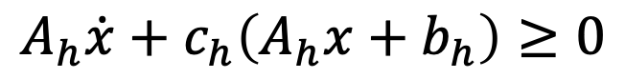
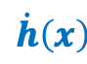
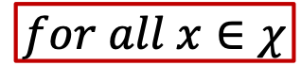
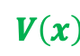
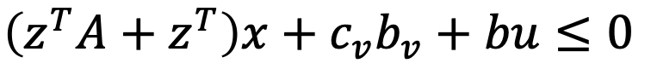
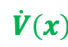
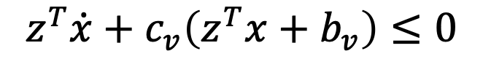
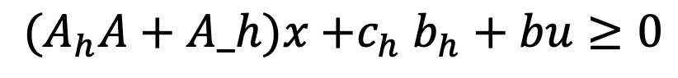
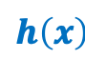
Theory, CBF and CLF
r = 1:
Safety Constraints by Control Barrier Function:
$$\dot{h}\left(x\right)$$
$$h\left(x\right)$$
$${(A}_{h}A+A_h)x{+c}_{h}b_{h}+bu≥0$$
CBF constraint
$$A_{h}\dot{x}+c_{h}\left(A_{h}x+b_{h}\right)≥0$$
Stability Constraints by Control Lyapunov Function:
$$\dot{V}\left(x\right)$$
$$V\left(x\right)$$
$$z^{T}\dot{x}+c_{v}\left(z^{T}x+b_{v}\right)≤0$$
$$\left(z^{T}A+z^{T}\right)x+c_{v}b_{v}+bu≤0$$
CLF constraint
$$for all x∈χ$$

Slide 10

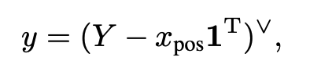
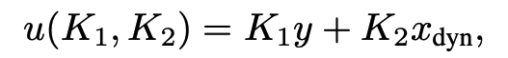
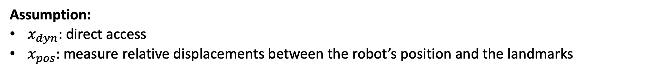
Theory, Controller
Landmark is a point whose location is known and fixed in the environment
Assumption:
$x_{dyn}:$ direct access
$x_{pos}:$ measure relative displacements between the robot’s position and the landmarks
Output:
col: displacement between each landmark and the current position of the system
feeds back linear combinations of displacements measurements

Slide 11
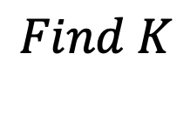
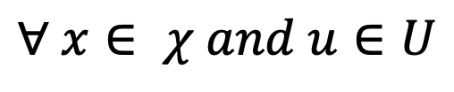
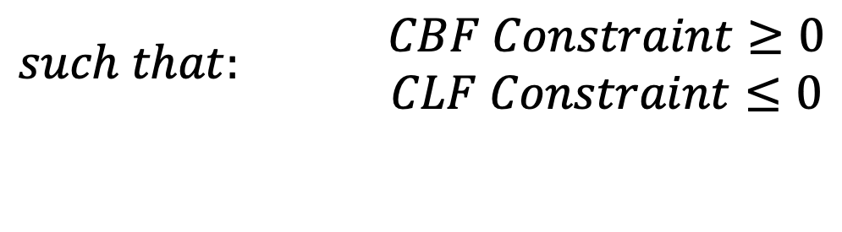
Theory
$$Find K$$
$$such that: \begin{matrix}CBF Constraint≥0 \\ CLF Constraint≤0\end{matrix}$$
$∀ x∈ χ and u∈U$

Slide 12
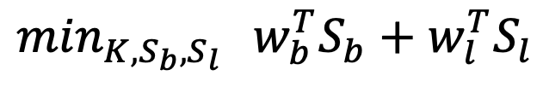
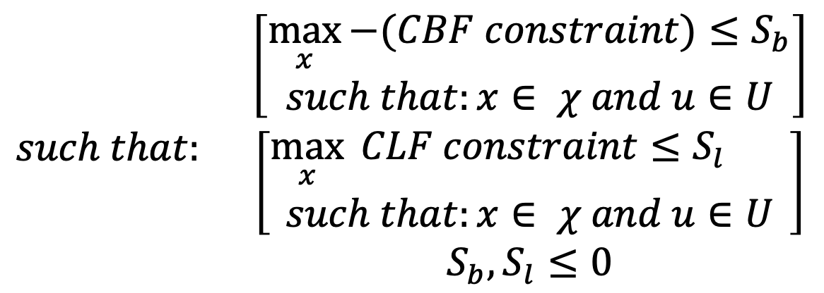
Theory, Min-Max
$$\min_{K,S_{b},S_{l}}{{ w}_{b}^{T}S_{b}+w_{l}^{T}S_{l}}$$
$$such that: \begin{matrix}\left[\begin{matrix}\max_{x}{−(CBF constraint)≤S_{b}} \\ such that:x∈ χ and u∈U\end{matrix}\right] \\ \begin{aligned}\left[\begin{matrix}\max_{x}{ CLF constraint≤S_{l}} \\ such that:x∈ χ and u∈U\end{matrix}\right] \\ S_{b},S_{l}≤0\end{aligned}\end{matrix}$$

Slide 13
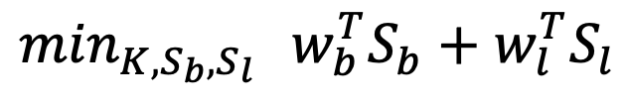
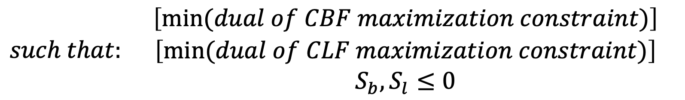
Theory, Min-Min
By taking the dual of the inner constraints:
$$\min_{K,S_{b},S_{l}}{{ w}_{b}^{T}S_{b}+w_{l}^{T}S_{l}}$$
$$such that: \begin{matrix}\left[\min{(dual of CBF maximization constraint)}\right] \\ \begin{aligned}\left[\min{(dual of CLF maximization constraint)}\right] \\ S_{b},S_{l}≤0\end{aligned}\end{matrix}$$

Slide 14
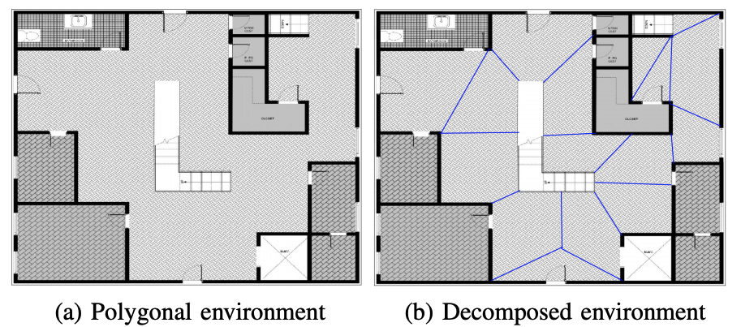
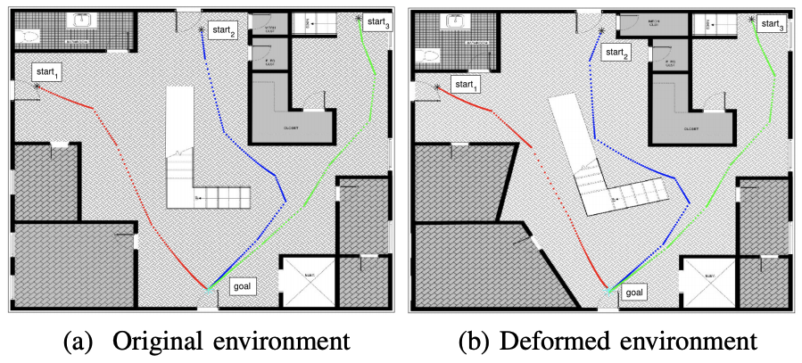
Example, First-Order (simple integrator)
(c)
(d)

Slide 15
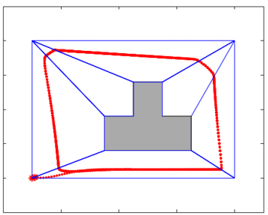
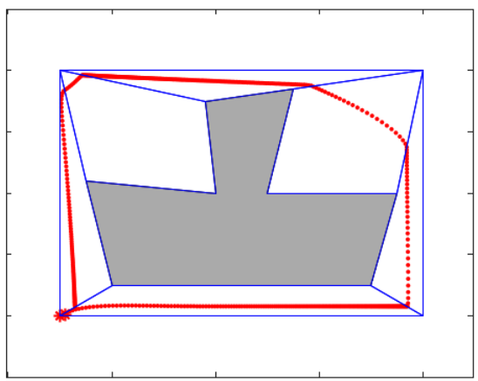
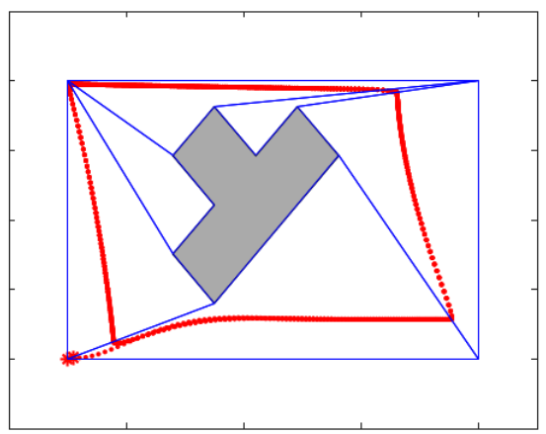
Example, Second-Order (double integrator)
(a) original environment
(b) deformed environment
(c) deformed environment

Slide 16
Control, Conclusion
Define a controller that depends on the environment indirectly.
Transform the min-max to min-min optimization problem
Find the robust controller to the significant change of the environment
Characterizing the solution set by finding all corners of convex solution set via LP
Verifiability probability, characterizes a priori reliability that can be expected from a given measurement graph
Detect the maximal verifiable component of a graph even the graph is non-verifiable

Slide 17
Any questions?
Thank you for joining my presentation

